Slide 1
Study Project: Digital Notebook

Slide 2
Pen with proximity sensor for writing
2D product sample
side of the device
Back
On / Off button
USB/battery charger

Slide 3
150mm
12.5mm
2D product sample
10mm
12mm
130mm
15mm
140mm
275 mm
253mm
20mm
2mm
12mm
2mm
8mm
10mm
10mm
10mm

Slide 4
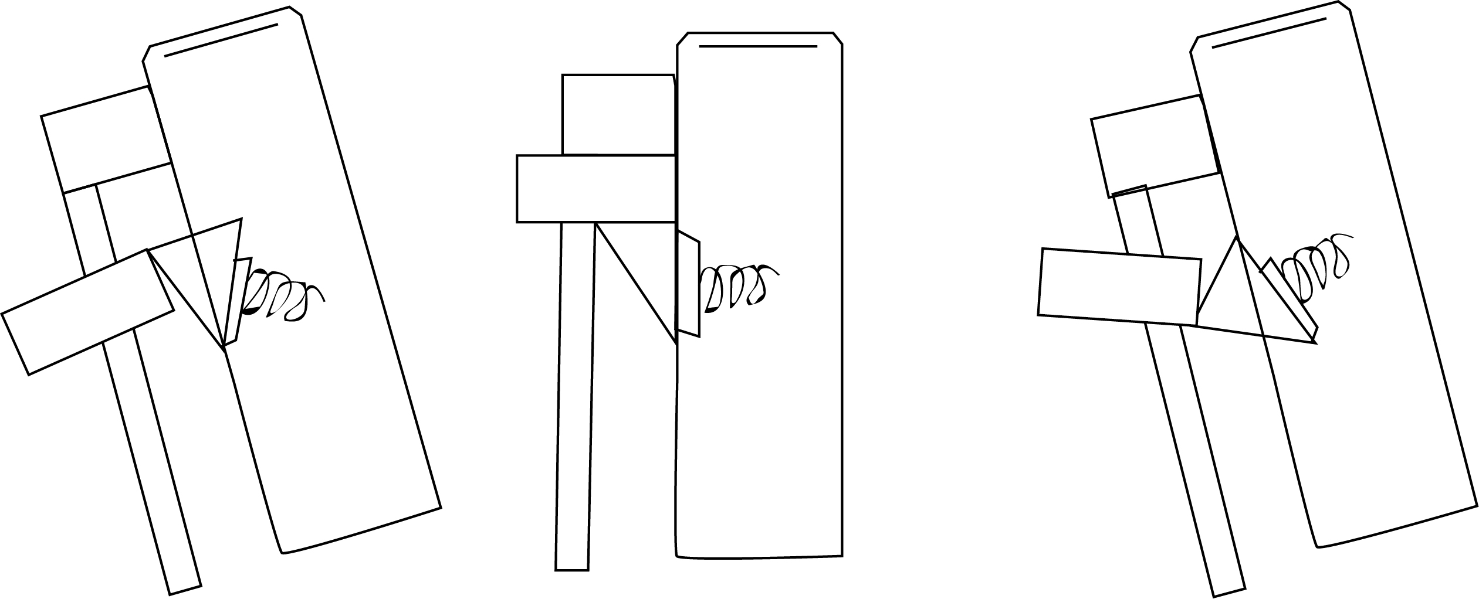

2D product sample - PEN
12mm
10mm
12mm
The pen has a lever
that performs
the lock with a snap.
Pen top
0,5mm
12mm
140mm
EMR sensor
The lid is place upwards
and unlocked by pushing
the projectile down.
20mm

Slide 5



2D product sample
Product style interface
Page 1
Page 2
Page 3
00/00/0000
00/00/0000
00/00/0000
Tabs
Hello, today i ll wish to write here...
Last note
Files list

Slide 6
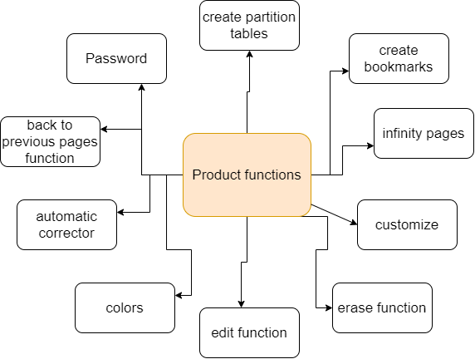
RoadMap

Slide 7
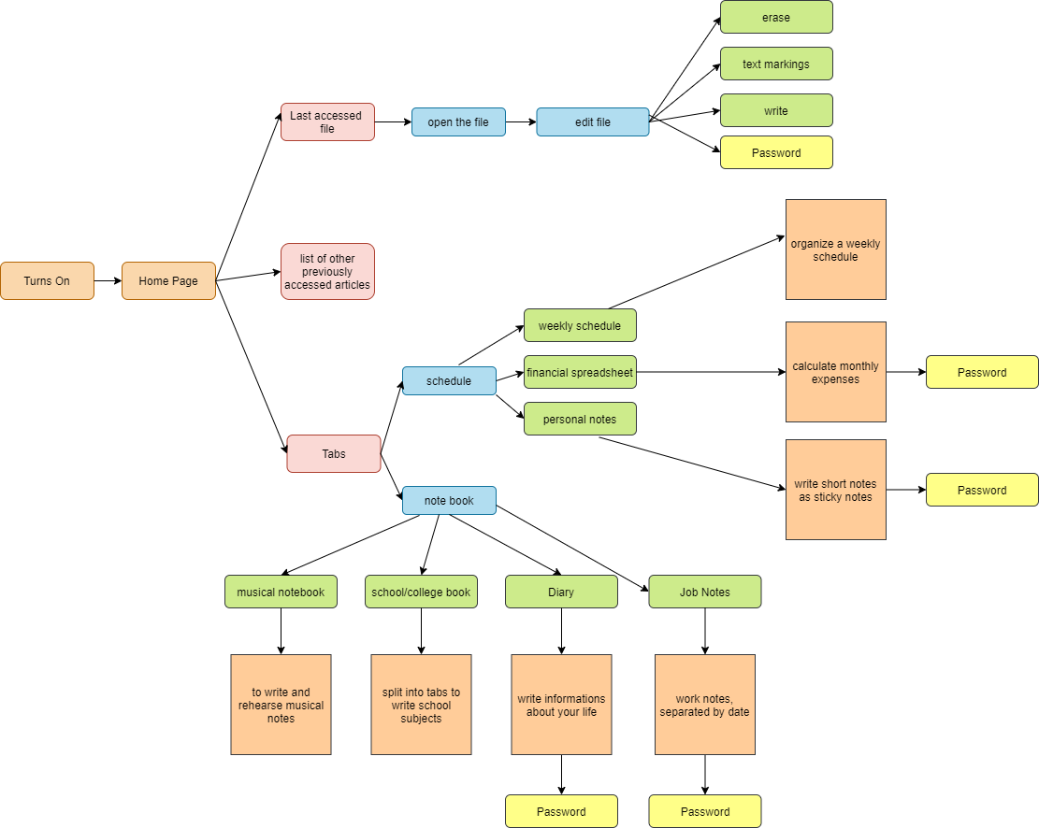
Fluxogram

